Slide 1
Numerical Problems
Somak Chatterjee

Slide 2
1

Slide 3
2

Slide 4
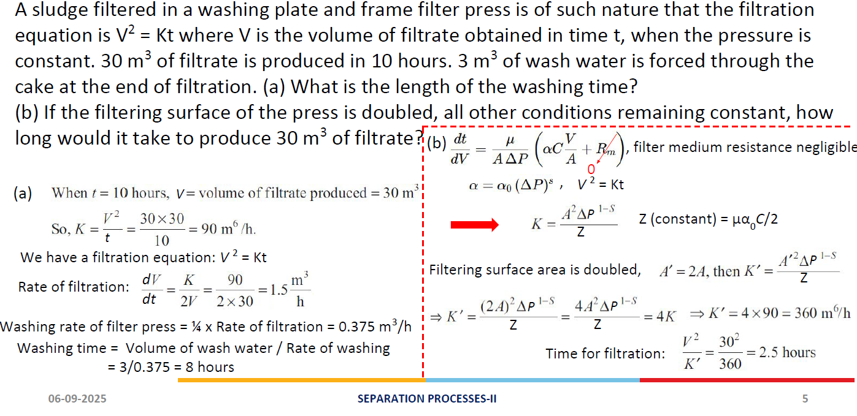
3

Slide 5
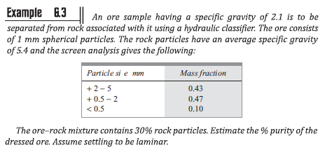
4
Z

